Slide 1
A
r_{S}=-0.07
p=0.79
N=15
B
C
r_{S}=0.09
p=0.86
N=19
DHE MFI in PBMCs
% of IFNγ⁺ CD8⁺T cells in PBMCs
% of TNF⁺ CD8⁺T cells in PBMCs
r_{S}=0.20
p=0.39
N=19
BMI
BMI
BMI
Suppl. Fig. 1. Production of ROS and proinflammatory cytokines in PBMCs. (A) ROS levels (=DHE MFI), percentages of IFNγ⁺ (B) and TNF⁺ (C) CD8⁺ T cells in PBMCs in relationship with BMI are shown. Spearman coefficient (r_{s}), sample number (N), and p-values are reported in each graph.

Slide 2
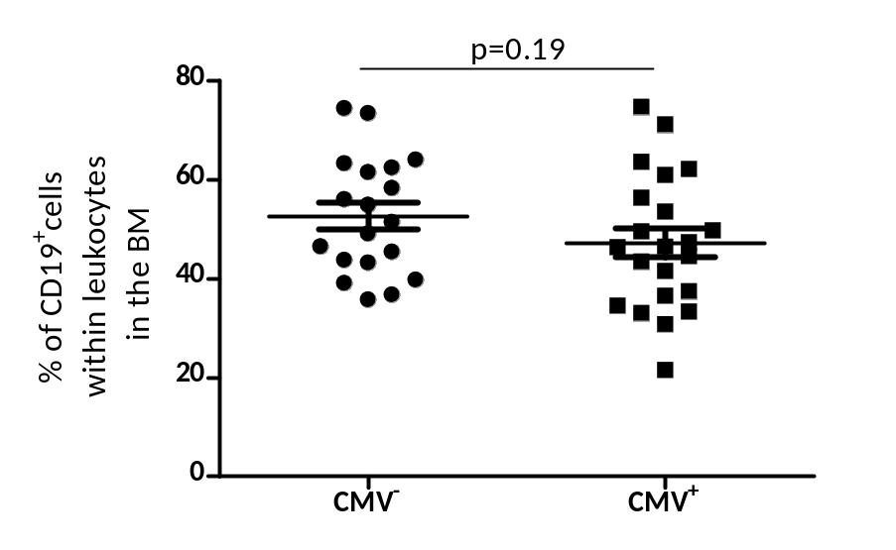
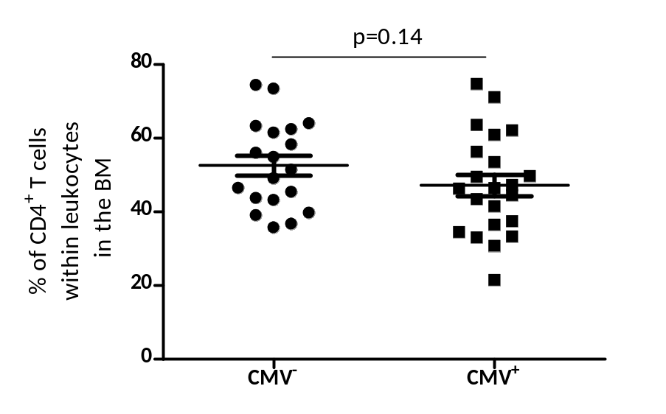
A
B
Suppl. Fig. 2.Frequency of T cells and B cells in the BM of CMV⁻ and CMV⁺ persons. (A) ROS levels (=DHE MFI), percentages of IFNγ⁺ (B) and TNF⁺ (C) CD8⁺ T cells in PBMCs in relationship with BMI are shown. Data are shown as mean ± SEM. Spearman coefficient (r_{s}), sample number (N), and p-values are reported in each graph.

Slide 3
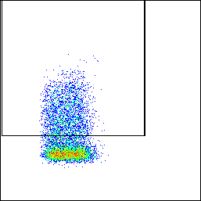
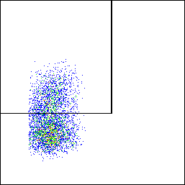
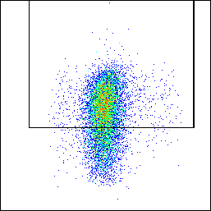
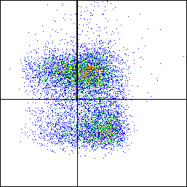
PD-1
IL-7Rα
KLRG-1
IL-7Rα
PD-1⁺
IL-7Rα⁺
KLRG-1⁺
MPEC
FSC-A
FSC-A
FSC-A
SLEC
KLRG-1
Suppl. Fig. 3. Gating strategy for PD-1, IL-7Rα, KLRG-1 and the combination IL-7Rα/KLRG-1 defining IL-7Rα⁺KLRG-1⁻ MPEC and SLEC. PD-1, IL-7Rα and KLRG-1 were gated within either CD8⁺ or CD4⁺ T cells, and MPEC and SLEC within CD8⁺ T cells, as shown in Figure 3.

